Slide 1




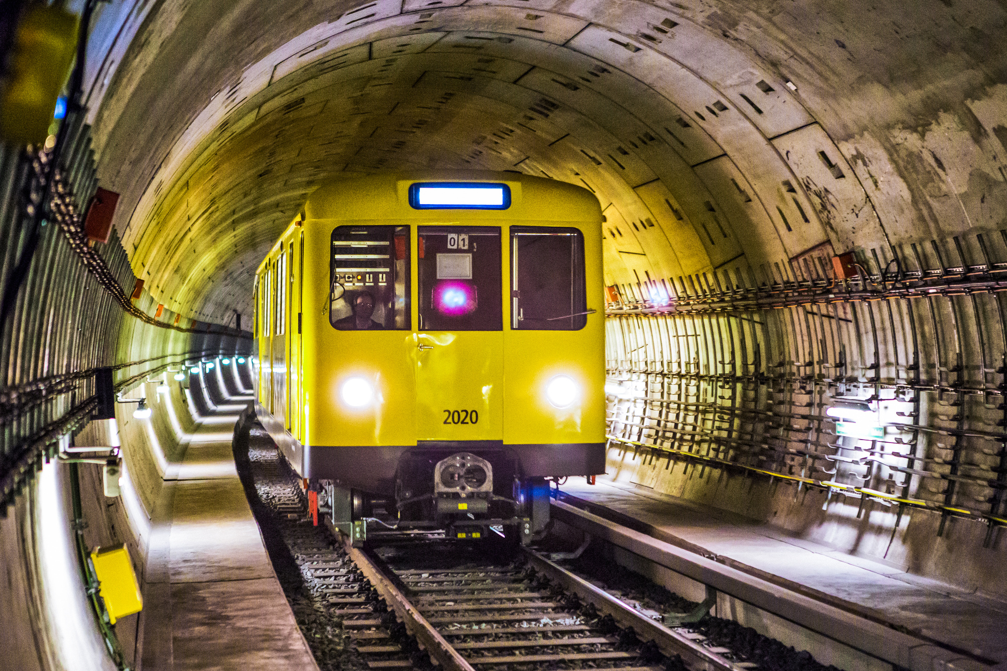
SCM518 FINAL PROJECT GROUP M1
Optimizing MetroFlow: Balancing Demand, Costs, and Capacity for Maximum Profit
Team Members:
Kinnari Parikh
Jeeval Sankpal
Naman A. Gupta
Venkata Siva Sri Sahith

Slide 2

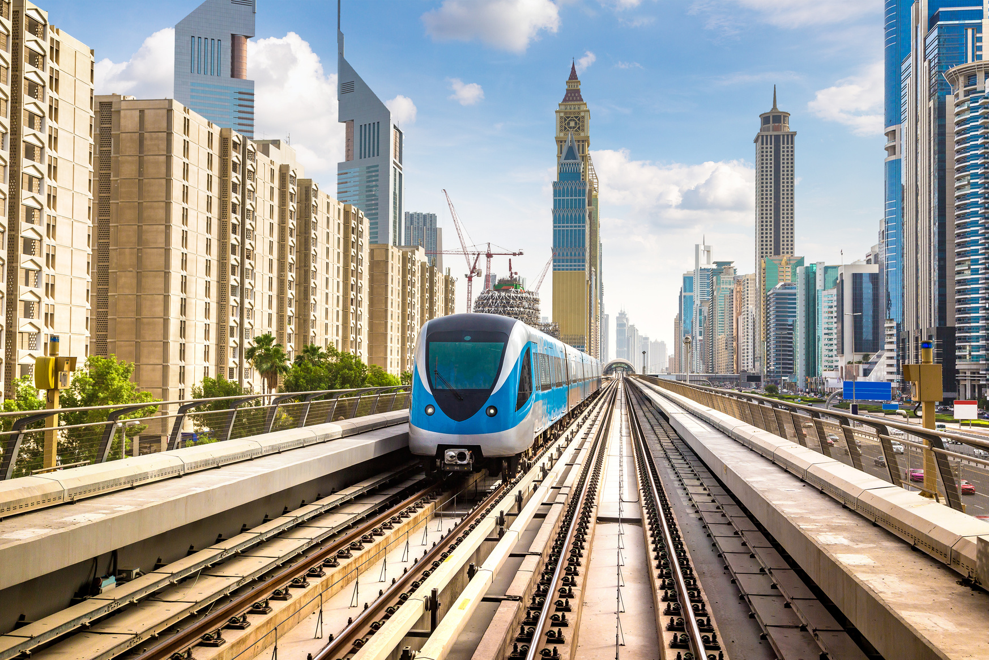
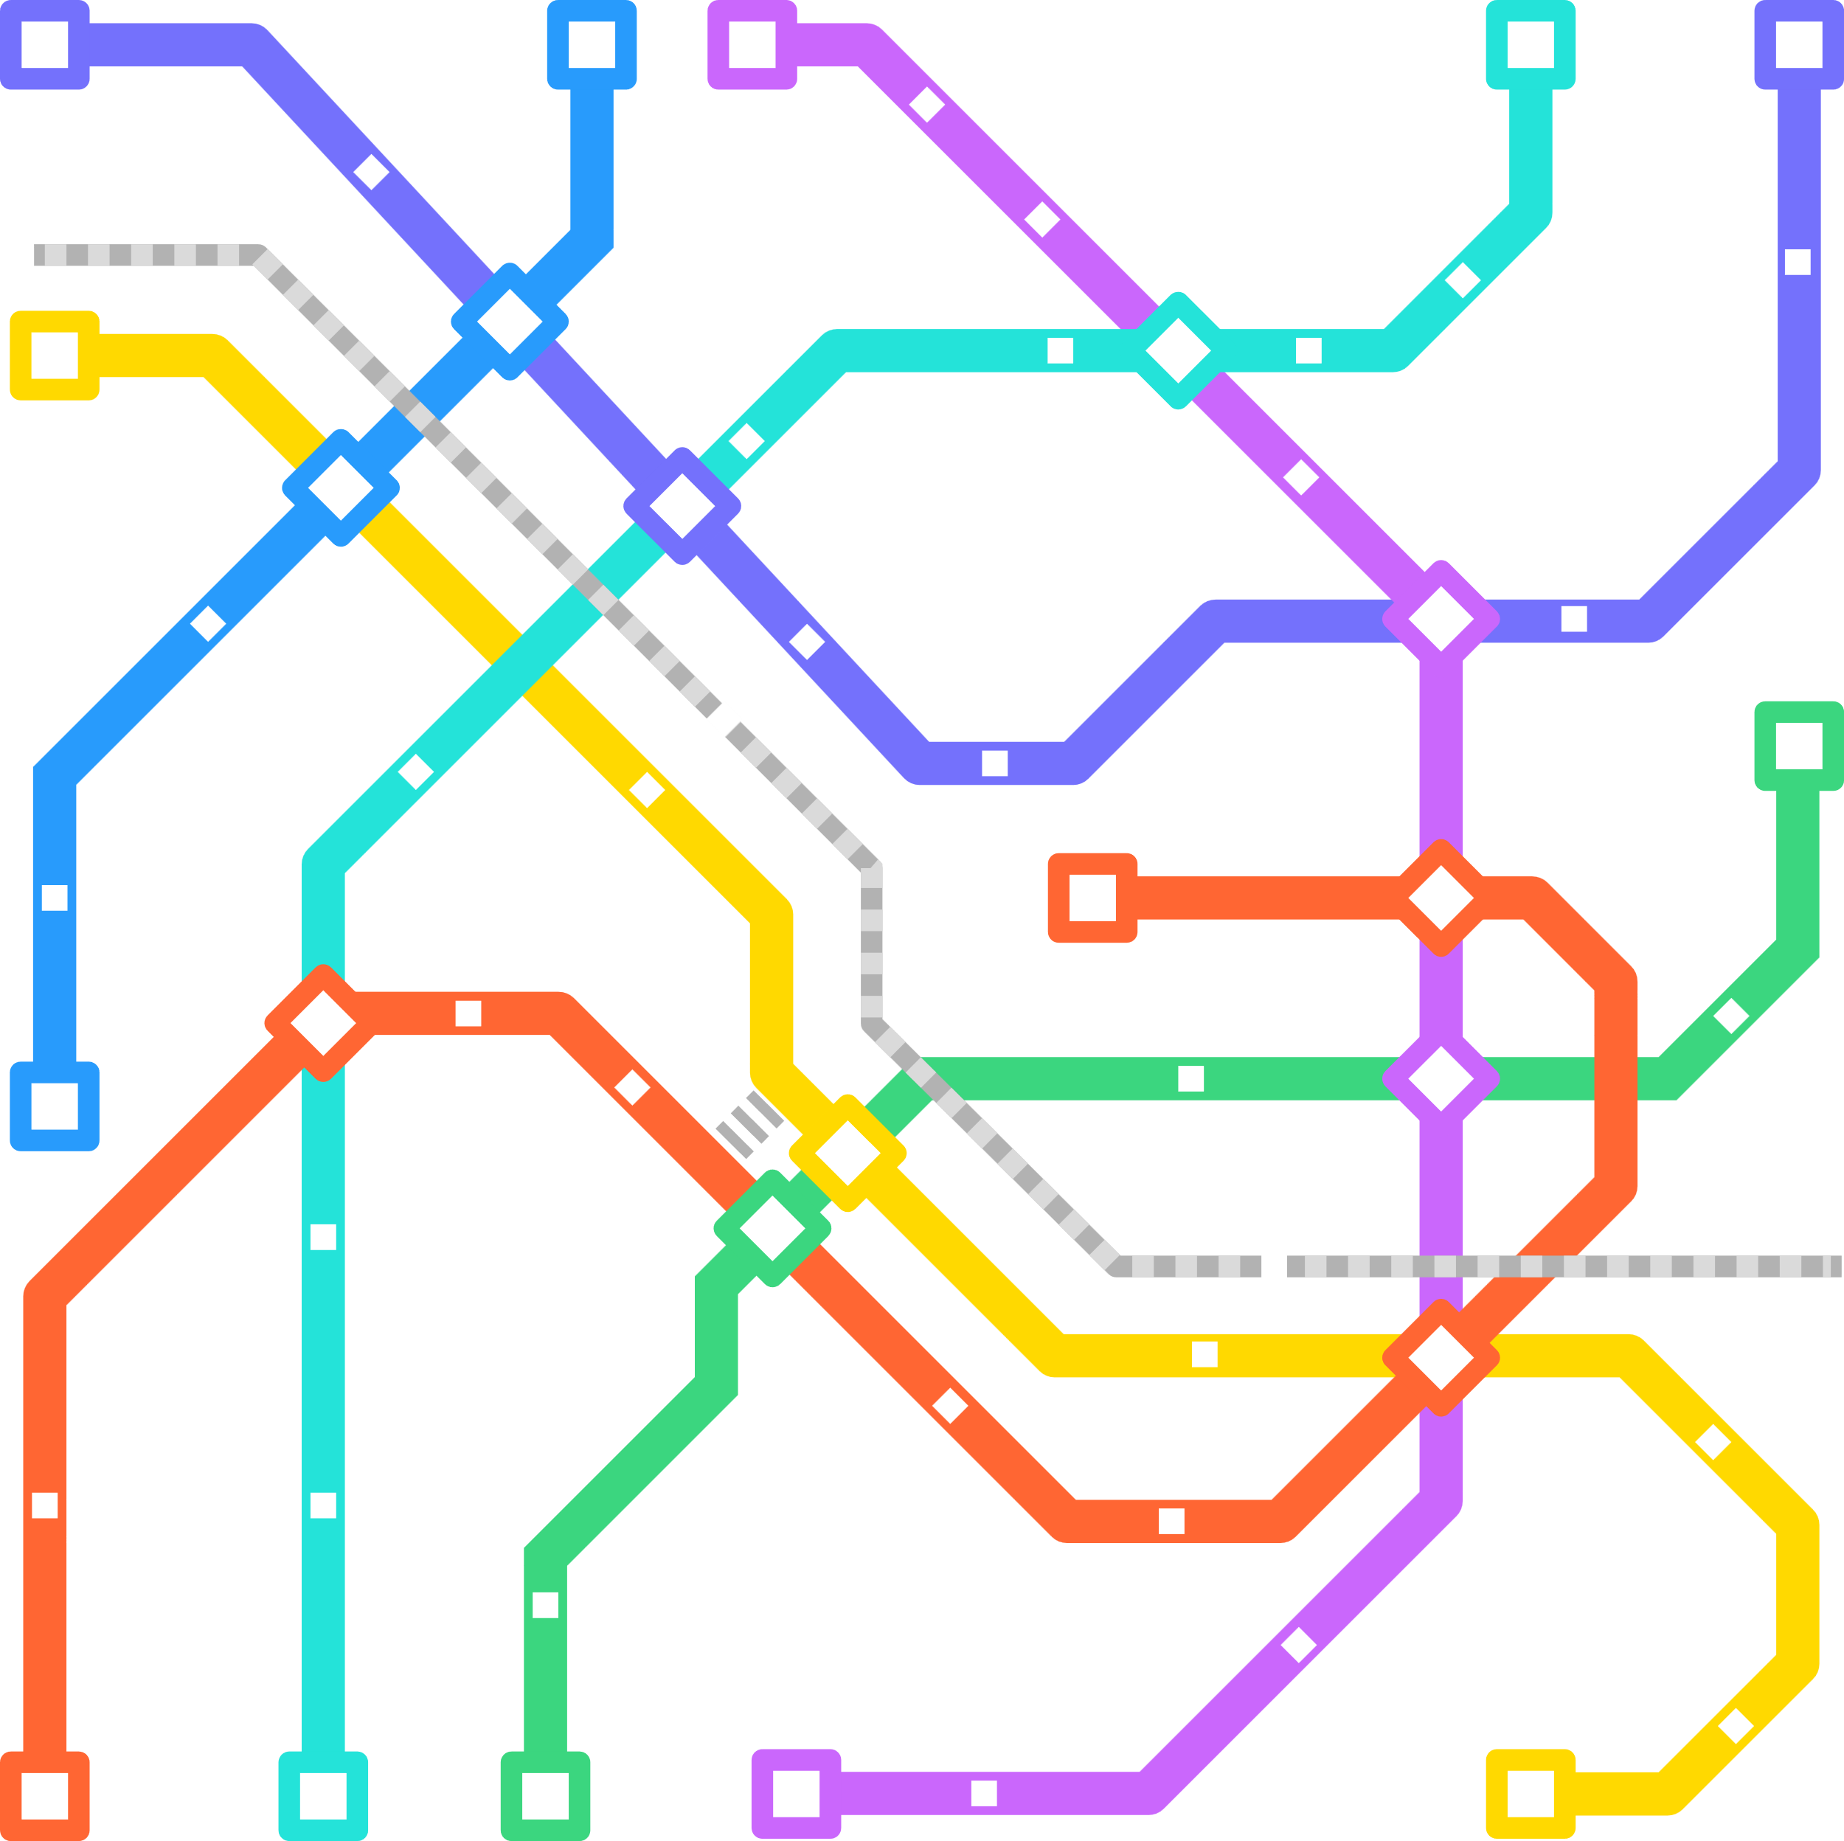





About us
MetroFlow is a public subway operator managing high-frequency urban and suburban rail services. In light of increasing ridership, fixed rolling stock, and raising energy cost.
It aims to optimize its its daily operations to ensure financial sustainability while meeting service quality expectations.

Slide 3


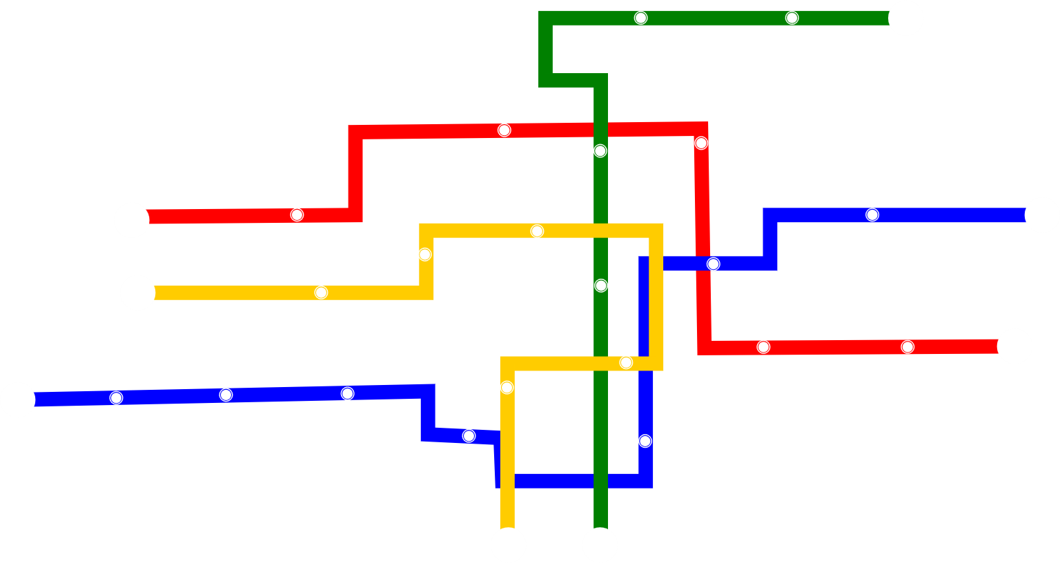






Overview of MetroFlow
Industry Expertise
Sectors Served
End-to-end safe and eco friendly transportation services.
High density urban areas during rush hour and off-peak times
Global Reach
Advanced Infrastructure
Covers the local travel needs of the entire city
State-of-the-art subway transportation facilities and a robust transportation fleet

Slide 4








Objectives
Maximize total daily profit from train operations, while still using up-to-date, well maintained train cars.
Ensure at least 85% of total passenger demand in met.
Allocate train cars and trips in a feasible, resource-constrained manner.

Slide 5

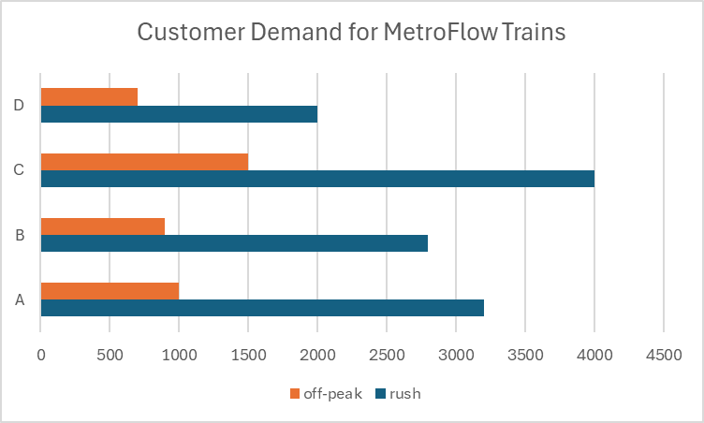

Problem Statement
MetroFlow must determine the optimal number of trips and the number of cars per trip to allocate across its 4 routes during rush and non-rush hours periods. The challenge is to strike a balance between maximizing revenue from ticket sales and minimizing operational costs- primarily energy costs, and maintenance/replacement expenses - while ensuring service quality and adhering to constraints on train and car availability.

Slide 6





Mathematical Model
Inputs
Decision Variables
Objective Function
Constraints

Slide 7
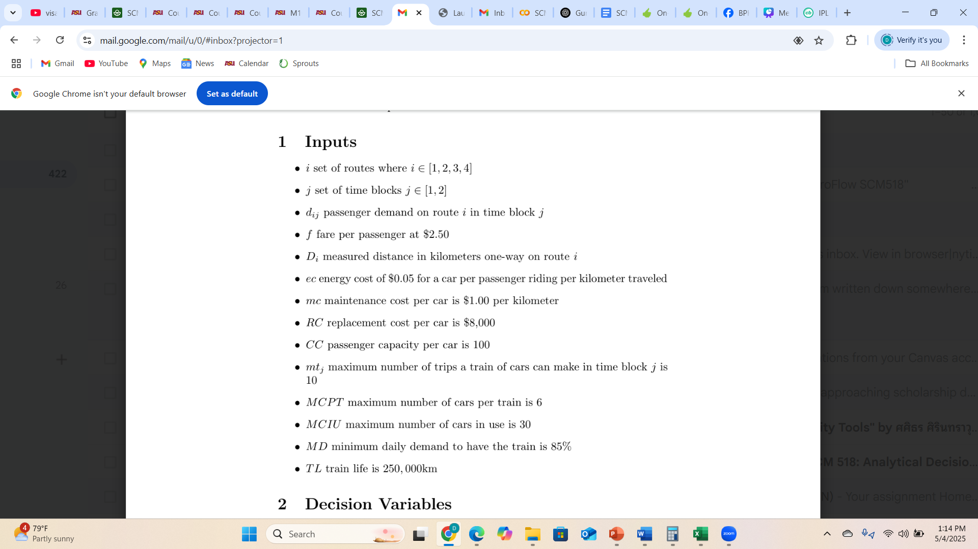
Mathematical Model

Slide 8
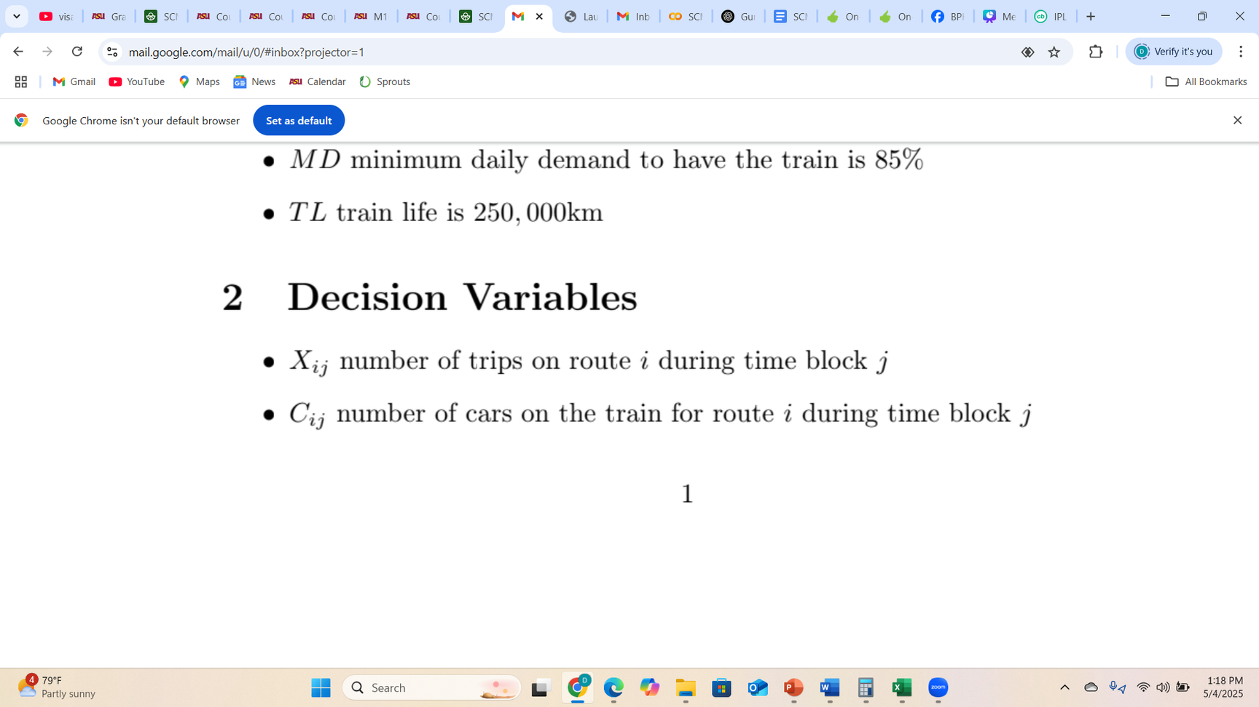
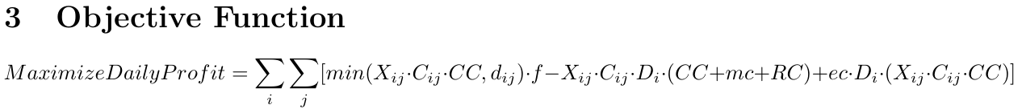
Mathematical Model

Slide 9
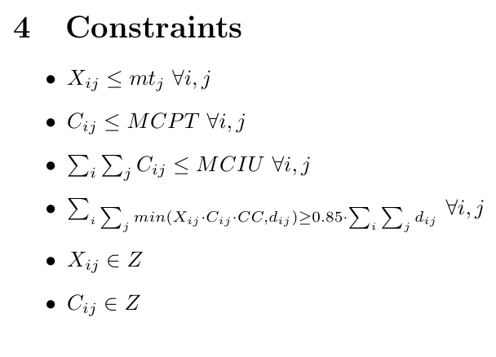
Mathematical Model

Slide 10




Excel Implementation
After completing our mathematical model, we implemented it in excel and performed the optimization on solver using GRG nonlinear.

Slide 11
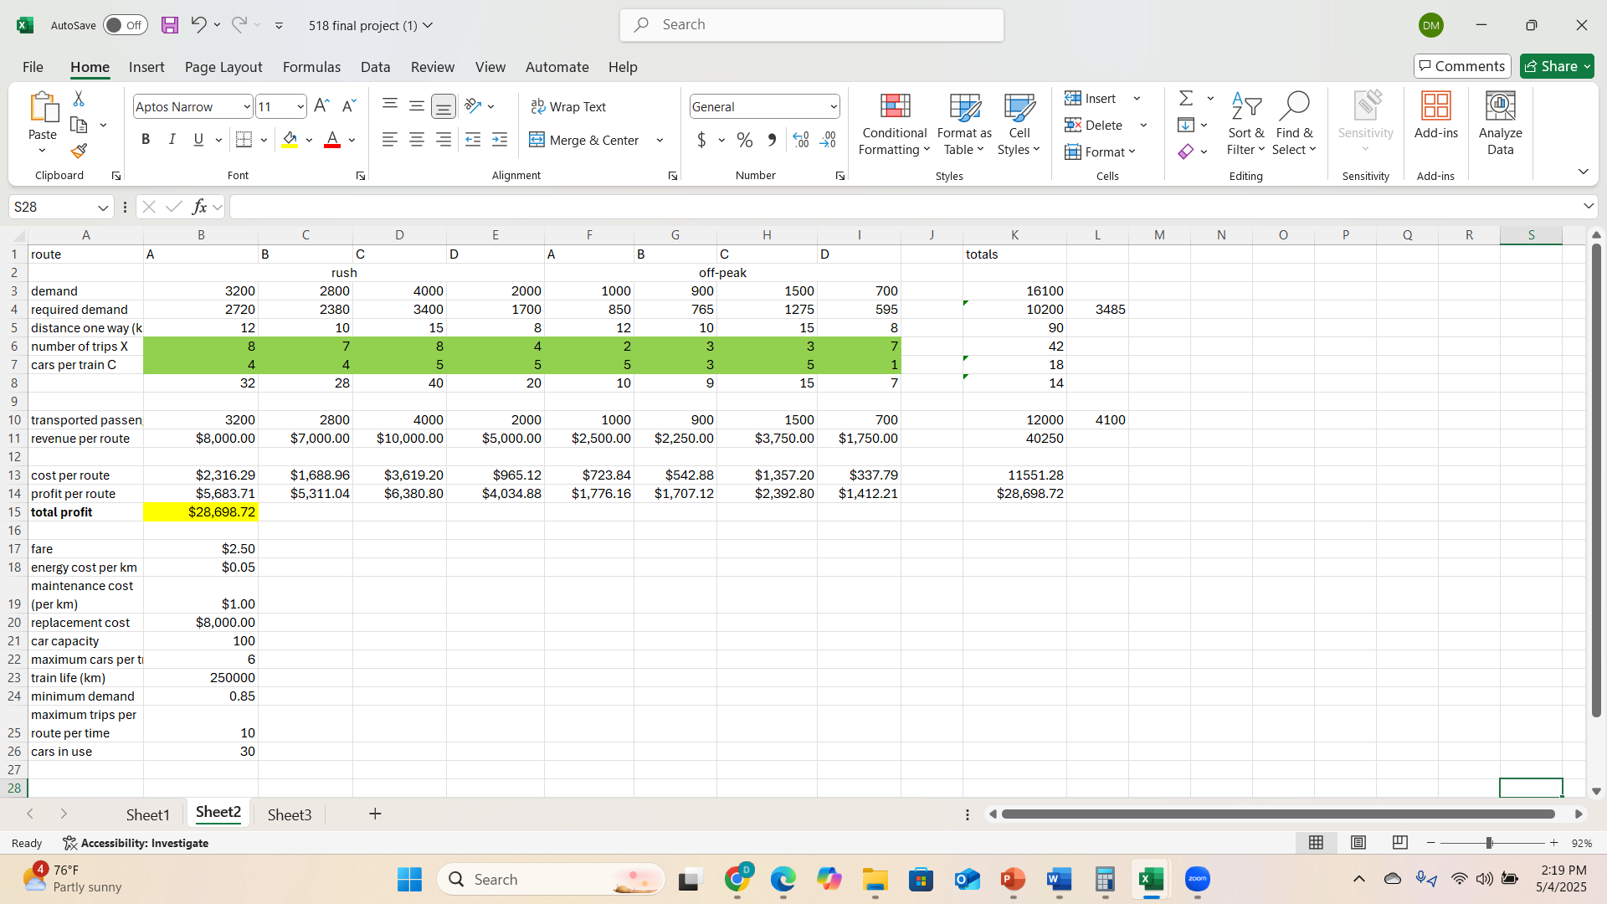
Excel Implementation
> As seen from the Excel model, our total profit of the optimized model is $28,698.72.
> The optimized number of trips X and cars per train C have also been found.

Slide 12
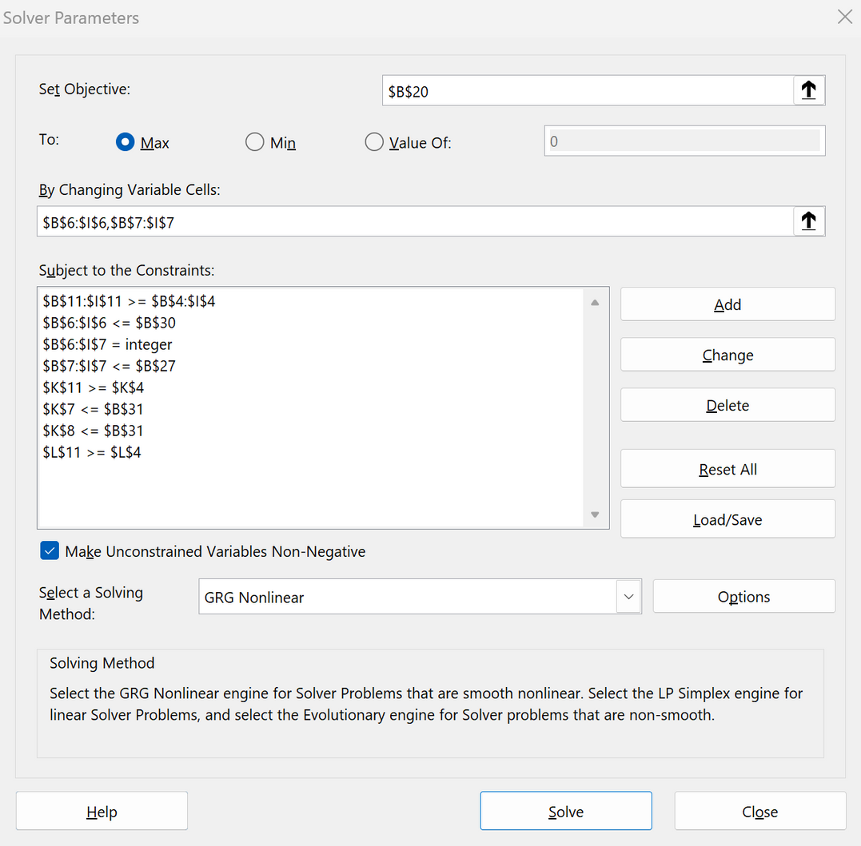
Constraints in the Solver
These are the constraint equations which were input in the solver dialog box

Slide 13

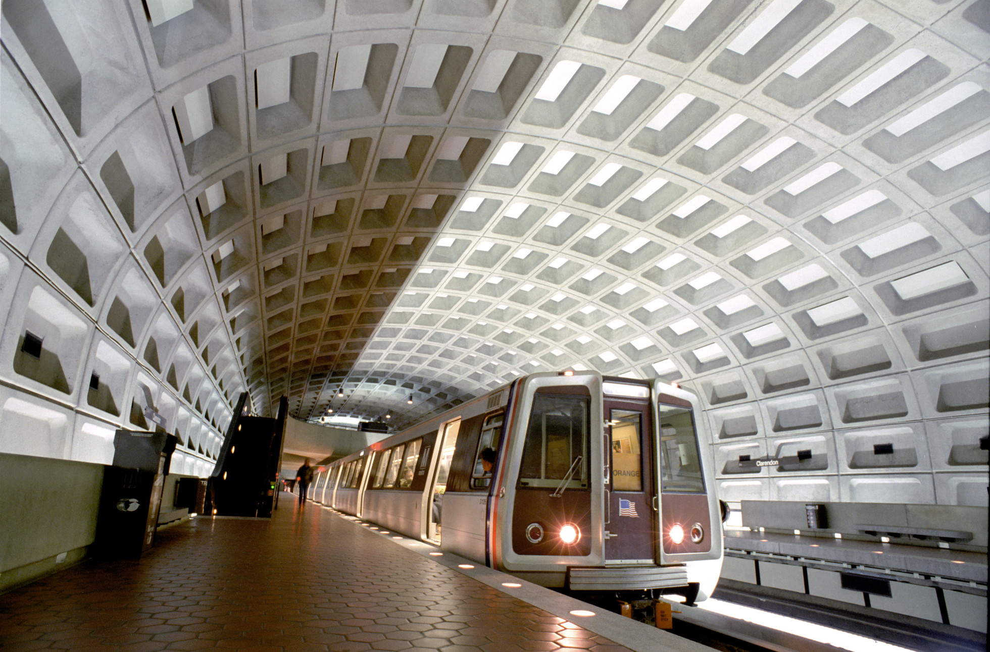

Python
Implementation

Slide 14


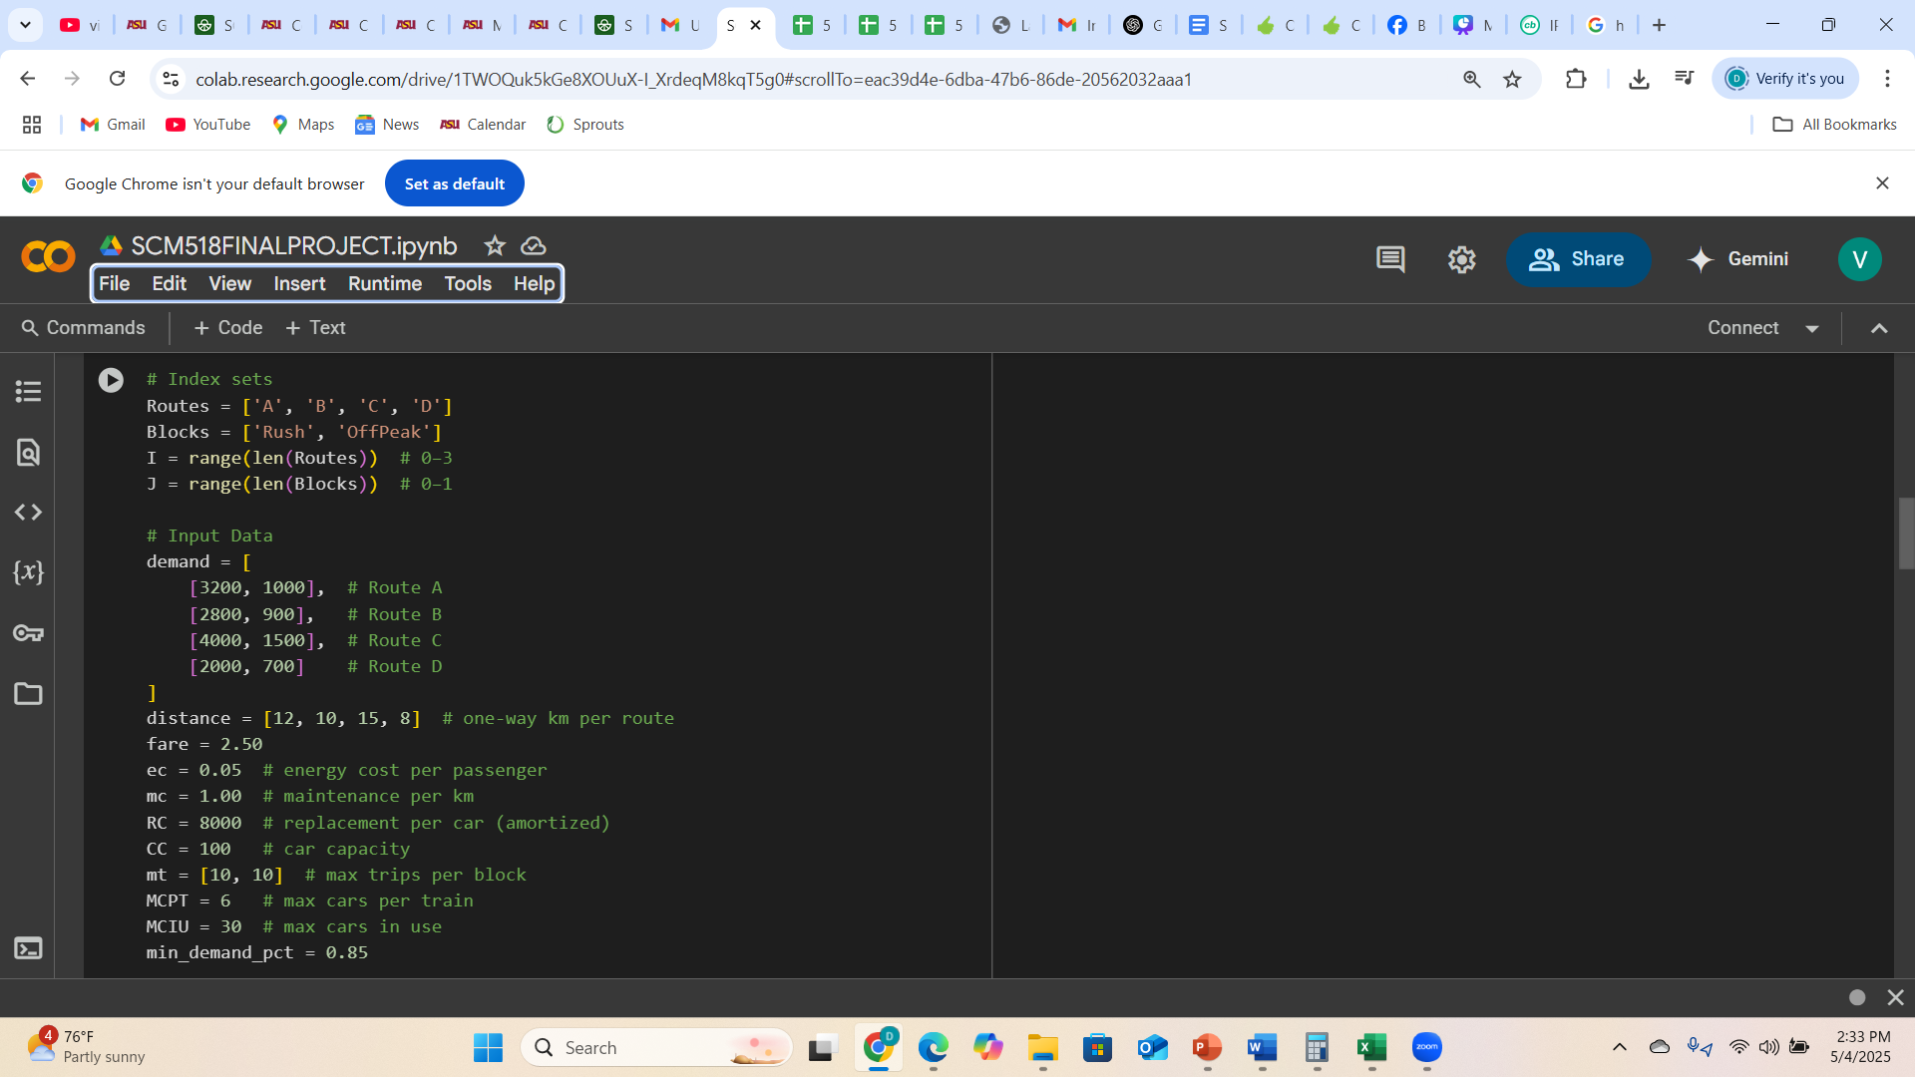
Inputs

Slide 15
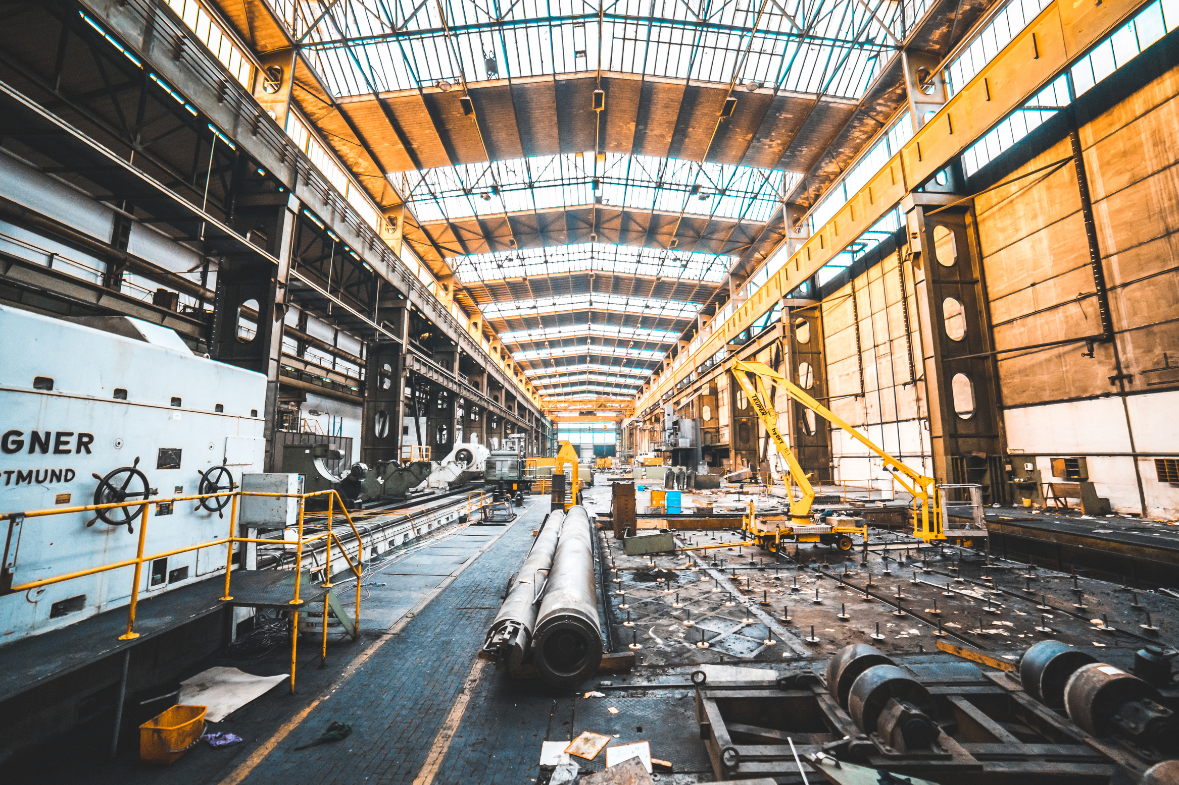
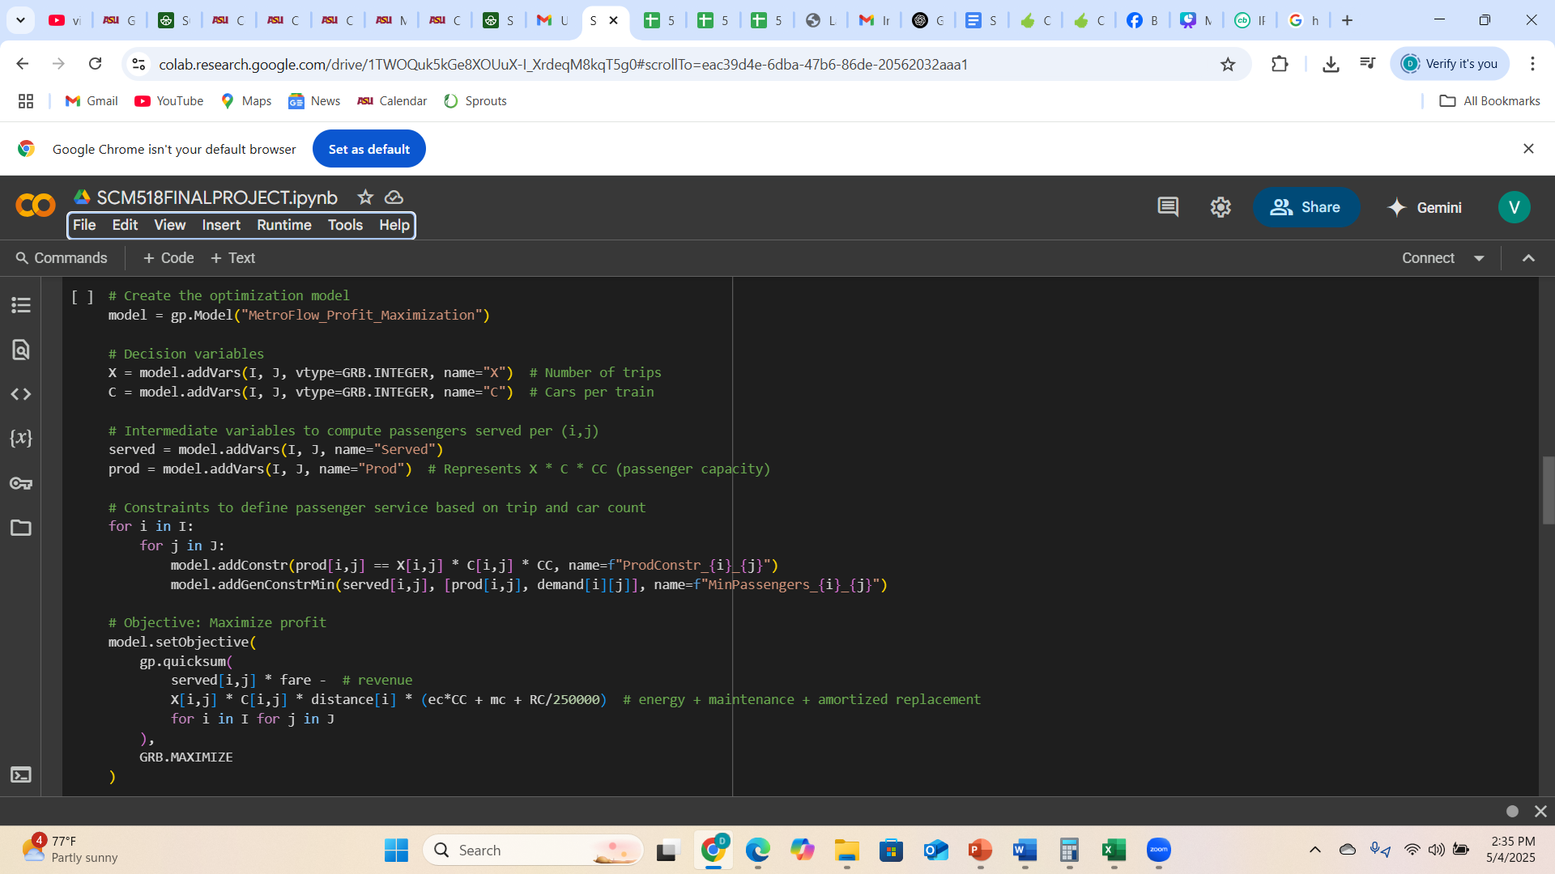
Decision Variables & Objective Function

Slide 16

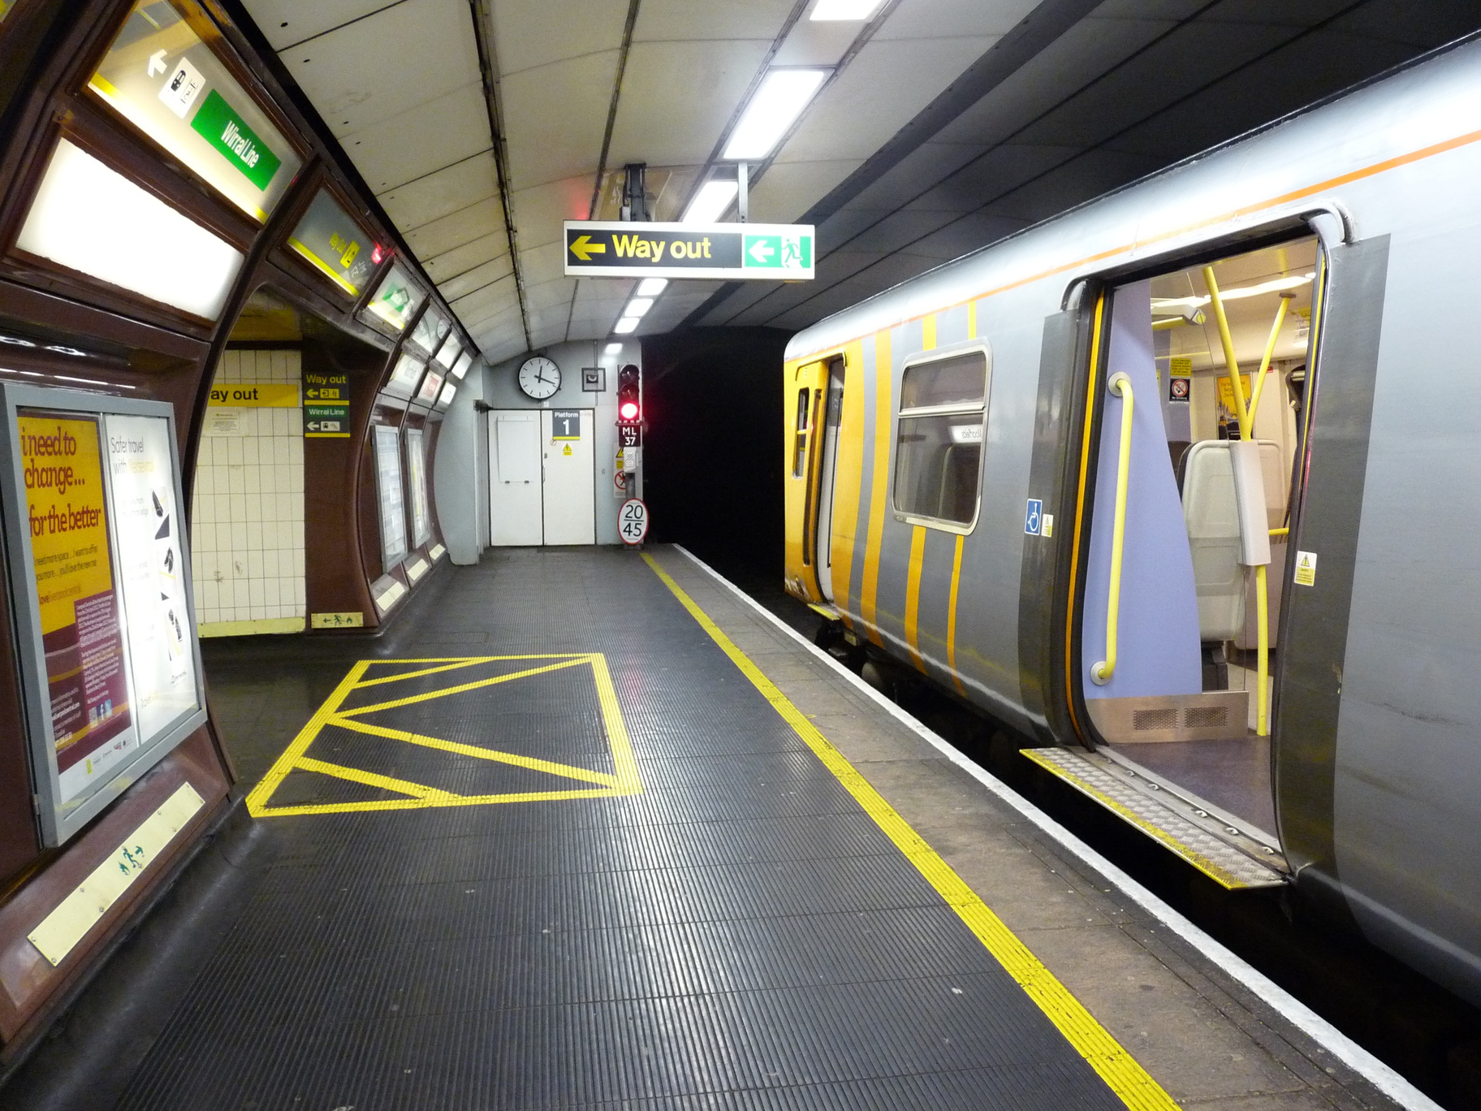
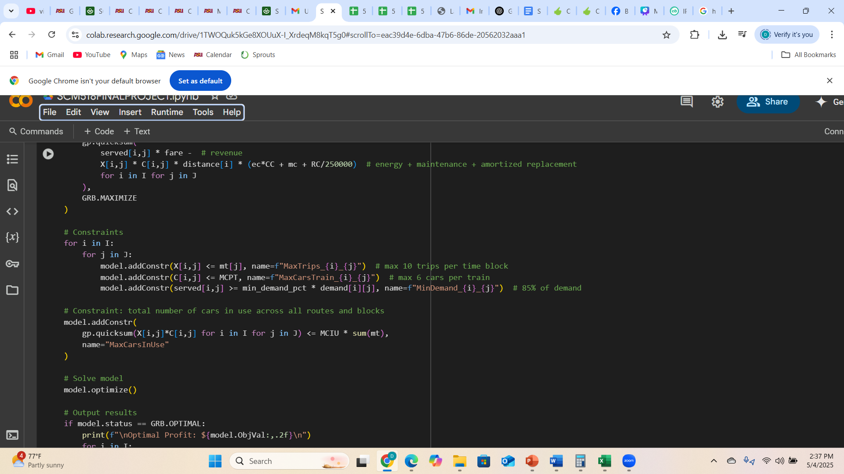
Constraints

Slide 17

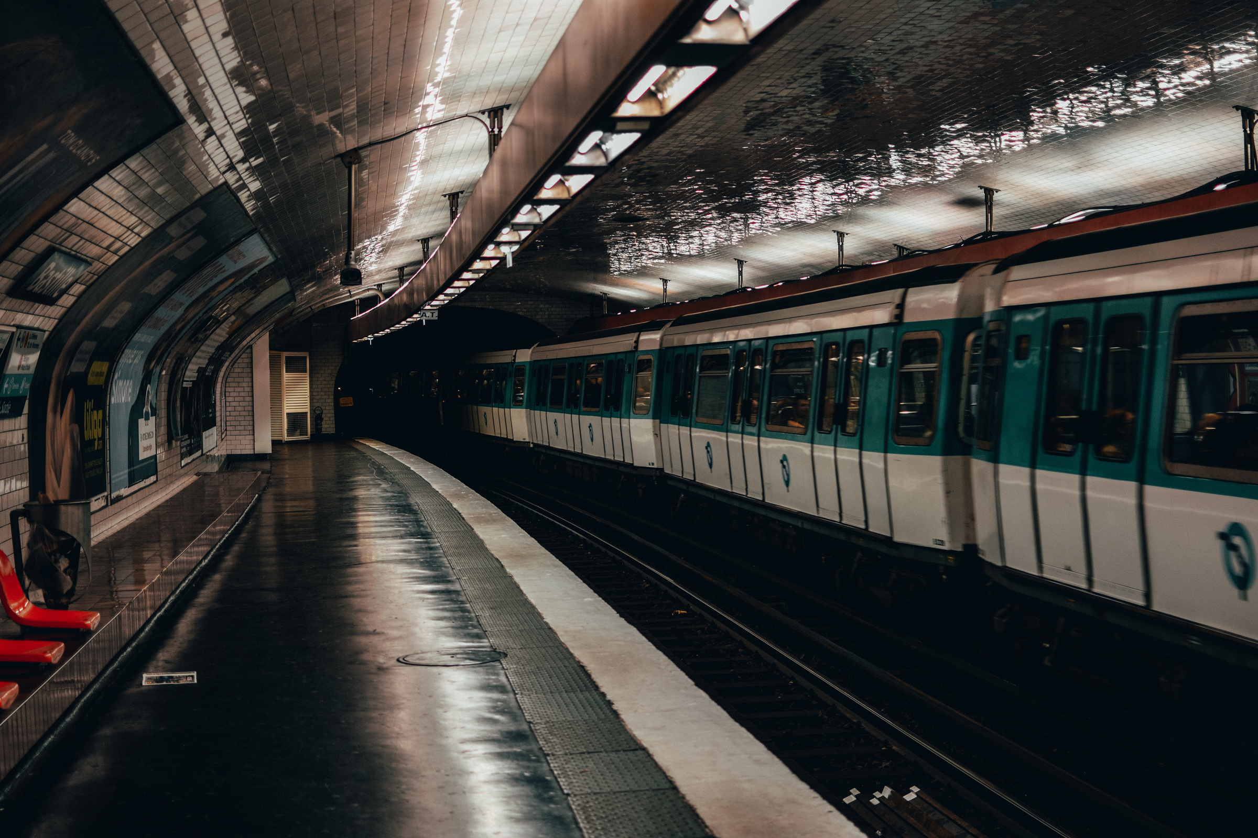
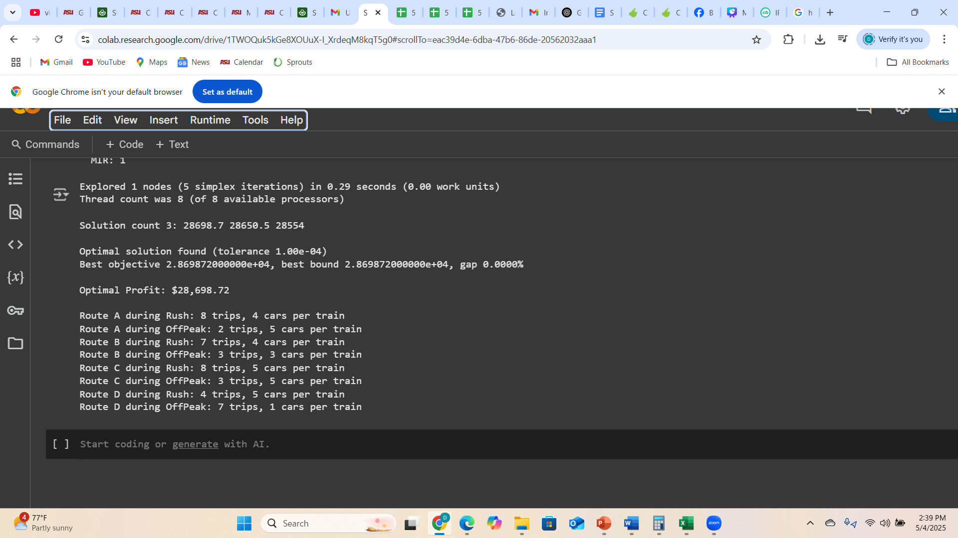
Python Output

Slide 18
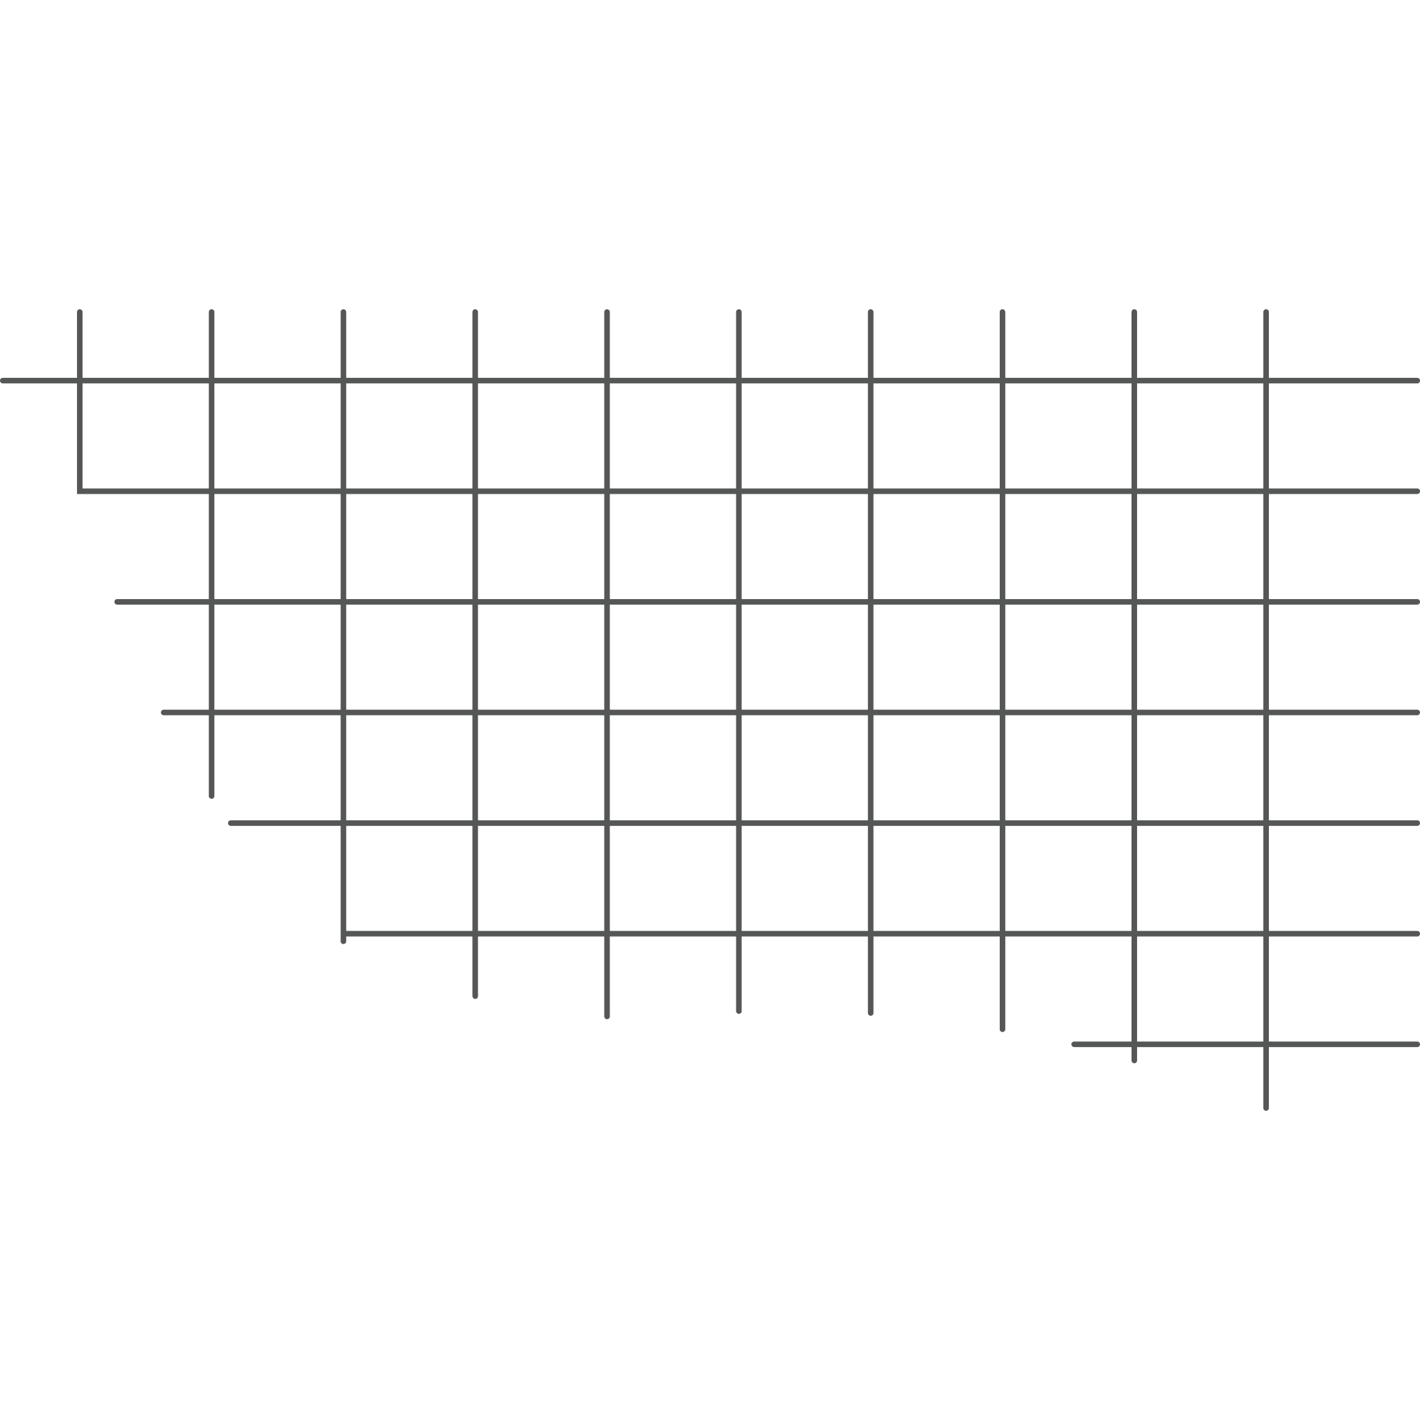


Conclusion
Optimizing train size and frequency, MetroFlow’s profit has doubled from approximately $14,000 to $28,698.72
Ensured 85% of passengers demand is met, balancing efficiency and service quality.
Optimized schedule considering train availability, car capacity and costs.
Improved profitability and reduced energy, maintenance, and replacement costs.

Slide 19

Thank You!

